Slide 1
The ABC of variant classification
Gunnar Douzgos Houge
Andreas Laner
Sebahattin Cirak
Nicole de Leeuw
Hans Scheffer
Johan den Dunnen

Slide 2
The one-dimensional ACMG/AMP system
P - Pathogenic
LP - Likely pathogenic (>90% / >95% for cancer)
VUS - Variant of uncertain significance
LB - Likely benign (>90% / >95% for cancer)
B - Benign
The system is best suited for dominant single-gene disorders of high penetrance.
Penetrance is not part of the classification system, and hypomorphic alleles cannot
be properly classified.

Slide 3
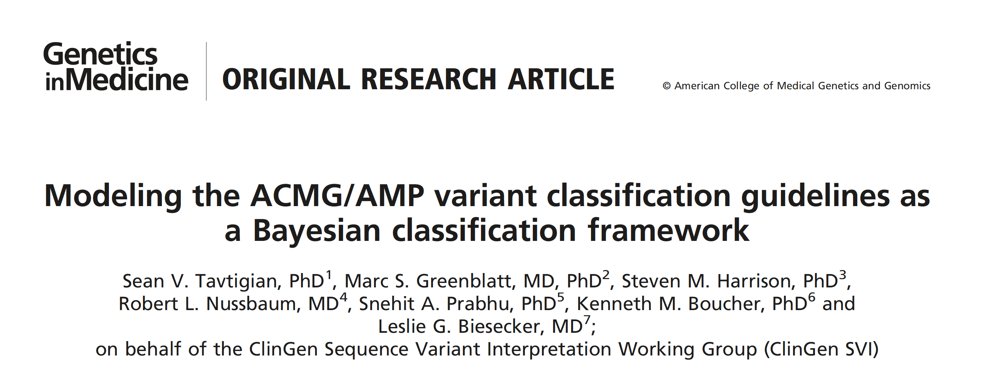
Beware that
The a priori likelihood that a variant is causative is set at 10%
The odds-of-pathogenicity is the square root of the value above: 350 – 18.7 – 4.3 – 2.08
(= very strong / strong / moderate / supportive)

Slide 4
New: The ABC system: A 2D-classification system
(step A+B) with standarized variant comments (step C)
Separates variant classification in a molecular and clinical arm, both with 0-5 grading
Both arms score a true unknown VUS as zero (functional VUS or clinical VUS)
Penetrance is taken into account
Hypomorphic alleles can be classified (always A class 4)
It does not matter if the cause is recessive or dominant - or chromosomal
Allows standarized variant comments dependent on clinical question
Requirements
Good clinical information – including family history when relevant
Good interaction between laboratory and clinic

Slide 5
2D grading: A+B
Step A: Functional grading
Functional effect
(e.g. LoF or GoF)
Likely functional effect, or
known hypomorphic allele
Hypothetical functional effect
Likely normal function
Normal function
Functional VUS
5
4
3
1
2
3
4
5
Step B: Clinical grading
Risk factor
Pathogenic
Pathogenic
Pathogenic
2
Right type of gene
1
Area of no clinical grading
0

Slide 6
Principles of the ABC system
Step A: Molecular grading 0-5
If step A>2: Step B: Clinical grading 0-5
Combined classification F-A, reported as class/A+B numbers: e.g. D/4+3
Step C: Pick the standarized class-related comment that best answers the clinical question
This promotes teamwork but can also be done by a single person
Variants are graded and commented one by one, but interpreted together

Slide 7
 | Functional classes | Score | «Risk» | Description
fVUS | Variant of unknown functional significance - a functional VUS, or fVUS | 0 | 0.10-0.50 | Variant of unknown functional significance - usually due to lack of knowledge.
NF | Normal Function (NF) | 1 | 0.00-0.01 | High frequency variant with no reason to suspect a recessive or hypomorphic role.
LNF | Likely Normal Function (LNF) | 2 | 0.01-0.10 | Moderate frequency variant with no reason to suspect a recessive or hypomorphic role.
HFE | Hypothetical Functional Effect (HFE) | 3 | 0.50-0.90 | Variant that could affect gene function based on biological knowledge and bioinformatic tools.
LFE | Likely Functional Effect (LFE), or Hypomorphic variant (in recessive disease) | 4 | 0.90-0.99 | Recessive: Variant that reduces gene function, but that only causes a biochemical abnormality - or disease - if in trans to a LoF allele. Dominant: Likely LoF or likely functional importance.
FE | Functional Effect (FE) | 5 | 0.99-1.00 | Variant that disrupt gene function (certain LoF) or known to be disease causing (known GoF or dominant-negative)
Table 1 Step A - Functional grading

Slide 8
 | Clinical classes | Score | Description
cVUS | Variant of unknown clinical significance - a clinical VUS | 0 | Variant of unknown clinical significance, e.g. a variant in a gene that is unlikely to be linked to the phenotype
Right type of gene | Variant of potential interest (VOI) | 1 | “The right type of gene” because the gene fits the phenotype: 1) Dominant variant that could be pathogenic 2) Single hypomorphic variant in a recessive gene that fits the phenotype
Risk factor | Known or assumed risk factor variant | 2 | 1) Low penetrance dominant variant 2) Dominant variant with good clinical support of a pathogenic role 3) Single pathogenic variant in a recessive gene that fits the phenotype
Pathogenic | Pathogenic variant | 3 | Pathogenic variant
Pathogenic | Moderate penetrance pathogenic variant | 4 | Dominant pathogenic variant of moderate (20-40%) penetrance
Pathogenic | High penetrance pathogenic variant | 5 | Dominant pathogenic variant of high (>40%) penetrance
Table 2 Step B - Clinical grading

Slide 9
Table 3 Combined class based on functional (A) and clinical (B) grading
A+B class | Grading combinations | Group | Examples of reporting recommendations (policy dependent)
0 | Functional grade 0-2 | 0-2 | Not reported - clinical grading unnecessary
F | Functional 3 + Clinical 0 | 3 | Not reported if the gene in question is unlikely to be related to the phenotype.
E | 3+1 / 3+2 / 4+0 / 4+1 / 5+0 | 4-5 | Variant-of-interest (VOI) group: Reporting optional: Single variant of potential interest in a gene that could be related to the phenotype (dominant or recessive).
D | 3+3 / 4+2 / 4+3 / 5+1 / 5+2 | 6-7 | Low penetrance and good candidate group: Reporting usually recommended.
C | 4+4 / 5+3 | 8 | Pathogenic: Disease-associated variant, always reported.
B | 4+5 / 5+4 | 9 | Pathogenic: Disease-associated variant of moderate penetrance.
A | 5+5 | 10 | Pathogenic: Disease-associated variant of high penetrance.
X | Functional 3-5 + Clinical 2-5 |  | Secondary/incidental/unsolicited/opportunistic finding

Slide 10
Table 4 Step C – Selection of a standard variant comment
(examples given, these comments can be adapted to suit local/national needs)
Class
0 Normal findings
F Normal findings – no pathogenic or likely pathogenic variants detected
F/E Normal findings – no pathogenic variants that could be related to the phenotype were detected
E/D Normal findings – no pathogenic variants that could explain the phenotype were detected
E/D Genetic variant of potential interest detected
E/D Heterozygosity for a recessive genetic variant of potential interest detected
E/D Homozygosity for a genetic variant of potential interest detected
E/D Combined heterozygosity for genetic variants of potential interest detected
D A genetic variant that increases susceptibility for this phenotype was detected
C/B/A A (+/- penetance) disease-associated pathogenic variant was detected
X A genetic variant unrelated to the clinical question was detected

Slide 11
Functional effect
Unlikely Likely
Clinical importance
Risk factor Pathogenic
fVUS
0
HFE
3
Risk
2
Pat
3
LNF
2
LFE
4
Match
1
Pat
4
NF 1
5 FE
cVUS - 0
5 - Pat
Step A: Functional grading
Step B: Clinical grading
NF = Normal Function
LNF = Likely Normal Function
fVUS = functional VUS
HFE = Hypothetical Functional Effect
LFE = Likely Functional Effect / hypomorphic allele
FE = Functional Effect (e.g. LoF or GoF)
cVUS = clinical VUS
Match = right type of gene for this phenotype
Risk = known risk factor / variant-of-interest
Pat = pathogenic variant,
penetrance-graded when known

Slide 12
A true VUS cannot be graded and is therefore a zero
Functional VUS (fVUS)
Variant with little/no molecular information = 0
Clinical VUS (cVUS)
Variant in a gene that is highly unlikely to cause the phenotype = 0

Slide 13
A
ACMG classification or ABC functional grading
ACMG classification
Pathogenic P
Likely pathogenic LP
VUS VUS+
VUS
Likely benign LB
Benign B
ABC functional “A” grading
5 Proven functional effect
4 Likely functional effect
4 Hypomorphic allele
3 VUS with hypothetical effect
0 VUS that cannot be classified
2 Likely normal function
1 Normal function
B
Genotype-phenotype-based grading if A is >2
giving a combined functional + clinical class
Clinical “B” grading Combined class
clinical + functional
5 Pathogenic, high penetrance (+ 5) A
4 Pathogenic, moderate penetrance (+ 5) B
3 Pathogenic (+ 5) C
2 Risk factor / susceptibility finding (+ 4-5) D
1 Potential gene-phenotype match (+ 3-4) E
0 No genotype-phenotype match (+ 3) F
C
Selection of a standard comment based
on combined class and clinical question

